Slide 1

More Than You Think
HL7 is people, HL7 is ideas, HL7 is collaboration

Slide 2
Healthcare Standards
Complex…. Slow…
Hard to use and understand
Require specialist skills, tools
Costly

Slide 3
Healthcare Standards
Complex…. Slow…
Hard to use and understand
Require specialist skills, tools
Costly
What if it didn’t have to be like that?

Slide 4
Introducing FHIR
Fast Health Interoperability Resources
Pronounced “Fire”
Based on industry best practices, with a focus on simplicity and implementability
…insert your fire related joke here….

Slide 5
Resources
Resources are:
“Things” that live on the web
Read/updated etc via HTTP
Known content and meaning
Identity (= location) – can be moved
Represented in XML or JSON (or others)
Molecules to build useful systems

Slide 6
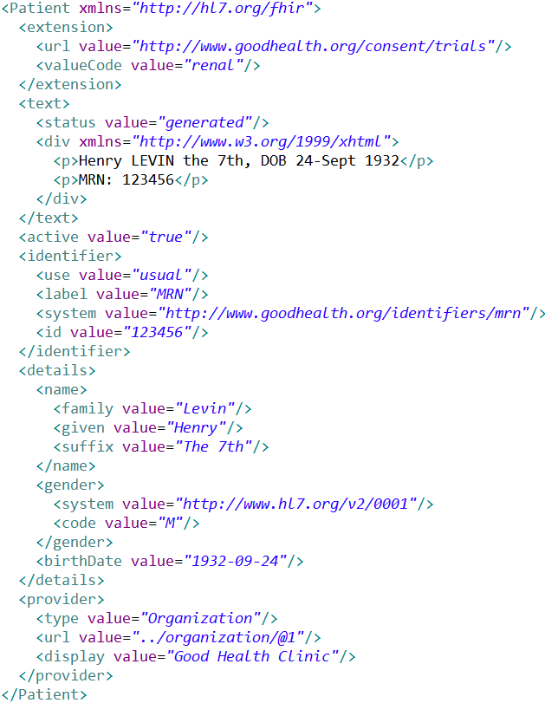
Extension with reference to its definition
Human Readable
Summary
Standard Data Content:
MRN
Name
Gender
Date of Birth
Provider

Slide 7
Resources have 3 parts
Defined Structured Data
The logical, common contents of the resource
Mapped to formal definitions/RIM & other formats
Extensions
Local requirements, but everyone can use
Published and managed
Narrative
Human readable (fall back)

Slide 8
Kinds of Resources
Administrative Concepts
Person, Patient, Organization, Device, Facility
Coverage, Invoice, etc.
Clinical Concepts
Allergy, Problem, Medication, Family History
Care Plan
Infrastructure Functionality
Document, Message, Conformance/Profiling

Slide 9
Using Resources
Classic HTTP RESTful approach
Simple approach led by Facebook, Twitter, etc.
Atom (RSS feed standard)
Use Atom to “bundle” resources
Pub/sub framework, Transactions, Messages (v2-like), Documents (per CDA)
Custom Services / SOA
Same content / base rules : portability

Slide 10
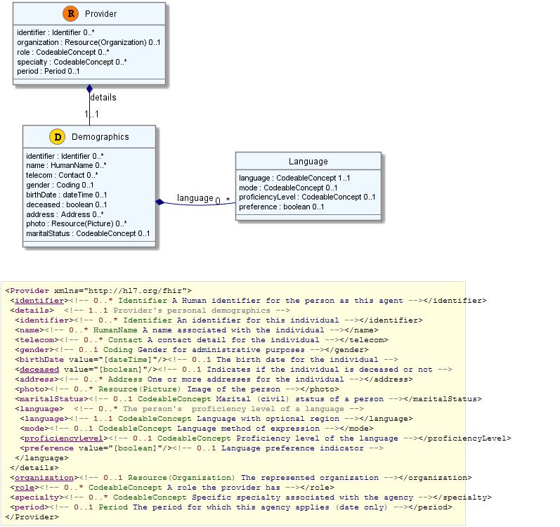

Slide 11
FHIR Ethos
Simplicity / Web alignment
Implementation focused
Reference Implementations published
Publically available test servers (now)
Connectathons
Freely available
http://hl7.org/fhir
Unencumbered – free for anyone to use

Slide 12
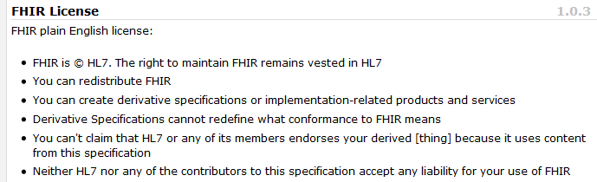
License

Slide 13
Extensions
Managing extensibility is a central problem
Everyone needs extensions, everyone hates them
FHIR tames extensibility
Built in extensibility framework (engineering level)
Define, publish, find extensions
Use them
This tames the overall specification

Slide 14
Collaborations
IHE
investigating - use of FHIR for MHD (mobile XDS)
DICOM
interested - RESTful access to image metadata
W3C
Semantic health group helping us with RDF
Lots of work to be done

Slide 15
Future Plans
2 Draft for comments complete
Infrastructure very solid (implementation focus)
Definitions & Mappings need work
Resource coverage needs to broaden
September ballot cycle – DSTU
DSTU = Draft Standard for Trial Use
Publish FHIR as full DSTU end 2013
Testing, real world implementation experience

Slide 16
Follow Up
Read the spec: http://hl7.org/fhir
Follow #FHIR on Twitter
Shape the specification:
Make comments online
Join the FHIR email list http://wiki.hl7.org/index.php?title=FHIR_email_list_subscription_instructions
Try implementing it
Come to the Connectathon!
Come to the next meeting (Atlanta in May)

Slide 17
FHIR
Simple…. FAST…
Easy to use and understand
Standard skills, tools
Cost-effective information sharing

